Slide 1
LTE Justification Plots
Market Name: Los Angeles
Site ID: CSL04566
Site Address: 202 W Ojai Avenue, OJAI CA 93023
ATOLL Plots Completion Date: Sep 25, 2020

Slide 2
Assumptions
Propagation of the site plots are based on our current Atoll (Design tool) project tool that shows the preferred design of the AT&T 4G-LTE network coverage.
The propagation referenced in this package is based on proposed LTE coverage of AT&T users in the surrounding buildings, in vehicles and at street level . For your reference, the scale shown ranges from good to poor coverage with gradual changes in coverage showing best coverage to marginal and finally poor signal levels.
The plots shown are based on the following criteria:
Existing: Since LTE network modifications are not yet On-Air. The first slide is a snap shot of the area showing the existing site without LTE coverage in the AT&T network.
The Planned LTE Coverage with the Referenced Site: Assuming all the planned neighboring sites of the target site are approved by the jurisdiction and the referenced site is also approved and On-Air, the propagation is displayed with the planned legends provided.
Without Target site: Assuming all the planned neighboring sites are approved by the jurisdiction and On-Air and the referenced site is Off-Air, the propagation is displayed with the legends provided.
Page 2
© 2008 AT&T Knowledge Ventures. All rights reserved. AT&T is a registered trademark of AT&T Knowledge Ventures.

Slide 3
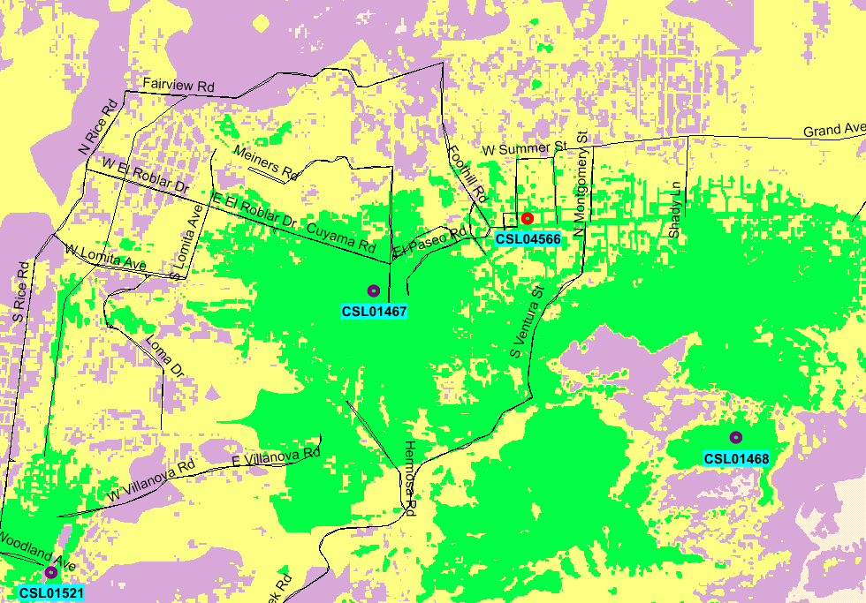



LTE Coverage Before site CSL04566
Page 3
© 2008 AT&T Knowledge Ventures. All rights reserved. AT&T is a registered trademark of AT&T Knowledge Ventures.

Slide 4
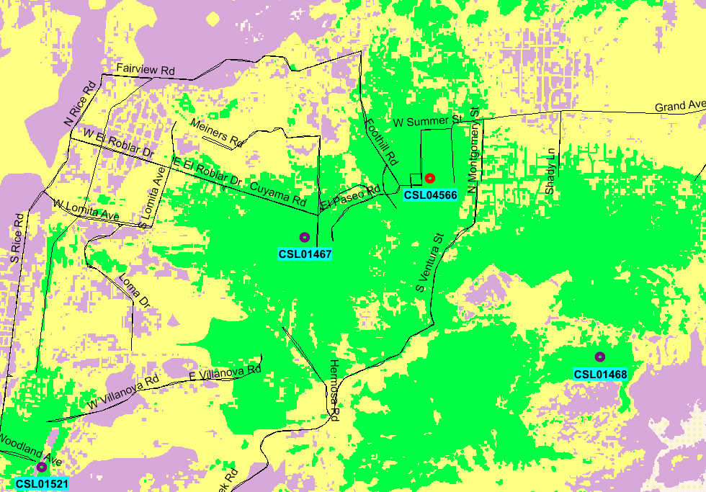
LTE Coverage After site CSL04566
Page 4
© 2008 AT&T Knowledge Ventures. All rights reserved. AT&T is a registered trademark of AT&T Knowledge Ventures.

Slide 5
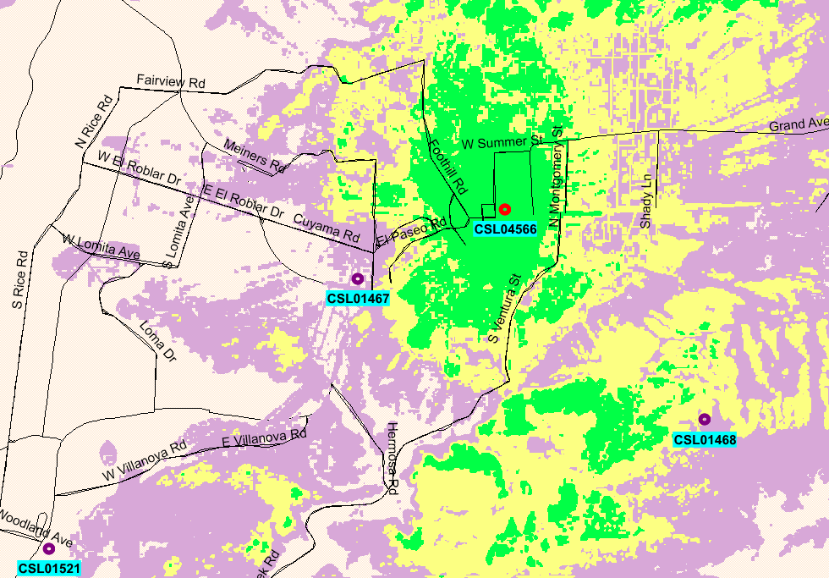
LTE Coverage standalone site CSL04566
Page 5
© 2008 AT&T Knowledge Ventures. All rights reserved. AT&T is a registered trademark of AT&T Knowledge Ventures.

Slide 6
Coverage Legend
In-Building Service: In general, the areas shown in dark green should have the strongest signal strength and be sufficient for most in-building coverage. However, in-building coverage can and will be adversely affected by the thickness/construction type of walls, or your location in the building (i.e., in the basement, in the middle of the building with multiple walls, etc.) In-Transit Service: The areas shown in the yellow should be sufficient for on-street or in-the-open coverage, most in-vehicle coverage and possibly some in-building coverage. Outdoor Service: The areas shown in the purple should have sufficient signal strength for on-street or in-the-open coverage, but may not have it for in-vehicle coverage or in-building coverage.

